Slide 1


CMR TECHNICAL CAMPUS
UGC(Autonomous)
Kandlakoya, Medchal Road, Hyd-501 401 Department of Computer Science Engineering
Mini Project On
CRIME RATE PREDICTION & ANALYSIS USING K-MEANS CLUSTERING
ALGORITHM
BATCH NO : 20
Project Guide: BATCH MEMBERS:
S.V Suji Aparna 217R1A05J6: T.Naga Surendar Reddy
Assistant Professor, CSE Department 227R5A0514: T.Rashmitha
227R5A0517: S.Mahendar
Project Coordinator:
K.Shilpa
Assistant Professor, CSE Department

Slide 2
CONTENTS:
Abstract
Introduction
Existing System
Disadvantages of Existing System
Proposed System
Advantages of Proposed System
System Requirements
Novelty of project
System Architecture
Modules
UML Diagrams

Slide 3
12. Sample code
13. Results
14. Conclusion
15. Future Scope
16. References
17. Github Link

Slide 4
ABSTRACT:
In India, the crime rate is increasing each day. In the current situation, recent technological influence, effects of social media and modern approaches help the offenders to achieve their crimes. Both analysis and prediction of crime is a systematized method that classifies and examines the crime patterns.
There exist various clustering algorithms for crime analysis and pattern prediction but they do not reveal all the requirements. Among these, K means clustering algorithm provides a better way for predicting the results.
The proposed research work mainly focused on predicting the region with higher crime rates and age groups with more or less criminal tendencies. We propose an optimized K means clustering algorithm to lower the time complexity and improve efficiency in the result.

Slide 5
INTRODUCTION:
Criminals are becoming more technologically sophisticated, making it challenging for intelligence and law enforcement agencies to analyze the large volume of data involved in crime and terrorist activities.
K-means clustering is a specific clustering technique that can be used to extract useful information from high-volume crime datasets and assist police in identifying and analyzing crime patterns to reduce further occurrences of similar incidents.
k means clustering is done with the help of rapid miner tool which is an open source statistical and data mining package written in Java with flexible data mining support options.
The knowledge gained from data mining approaches is useful and supports police forces in identifying and analyzing crime patterns.

Slide 6
EXISTING SYSTEM:
Crime analysis tool is developed using various distinct data mining methods. It supports the police officers for investigating crimes.
Implementing a clustering algorithm on crime datasets enables analysis of crimes. It makes identification and analysis of various criminality trends over the years through their conclusion.
The random initial starting points produced by K-means which gives results in the form of cluster that helps in reaching the local optima. So to overcome this problem, the partitioned data along with the data axis with the highest variance for assigning the initial centroid for K-Means clustering was applied.
So it is observed that the proposed technique uses a lesser number of iteration thereby reducing the clustering time.

Slide 7
DISADVANTAGES OF EXISTING SYSTEM:
Less Accuracy
Low Efficiency
Dependency on Historical Data
User Input Errors
Limited Scope of Crime Types

Slide 8
PROPOSED SYSTEM:
We are working on Spyder for implementation. Here we use a Spyder 3.7 version. Spyder is an integrated development environment for systematic programming in Python. Here we implemented different packages like matplotlib,numpy,sklearn, pandas,etc.
Which helps to plot elbow graph and data frame table using a K-means clustering algorithm? Dataset is collected from Kaggle datasets and import datasets into Spyder in CSV format.
We perform normalization for finding the accurate number of clusters (k) using the elbow method. The elbow method performs k- means clustering on the obtained dataset for a range of values of k (2-15) and calculates the SSE.

Slide 9
ADVANTAGES OF PROPOSED SYSTEM:
High Accuracy
High Efficiency
Historical Data Management
User-Friendly Interface
Identification of Crime Patterns

Slide 10
SYSTEM REQUIRMENTS
HARDWARE REQUIRMENTS:
System Processor : Intel i3(MIN)
Hard Disk : 40GB(MIN)
RAM : 4GB(MIN)
Monitor : LED or LCD

Slide 11
SOFTWARE REQUIREMENTS:
Operating system : Windows8 or Above.
Coding Language : python
Frontend : html,css,javascript
Backend : python

Slide 12
NOVELTY OF PROJECT:
Enhanced Predictive Accuracy: The proposed system utilizes an enhanced version of the K-means clustering algorithm, which incorporates advanced techniques to improve clustering accuracy.
Real-Time Data Processing: The system is designed for real-time data processing, allowing for immediate updates and analysis as new crime data is entered.
Clustering Co-Offenders and Crime Patterns: The system employs K-means clustering not only to analyze crime locations but also to identify relationships between co-offenders and organized crime groups.
User-Friendly Interface: The project emphasizes a user-friendly interface that simplifies data entry and analysis for law enforcement personnel.

Slide 13
SYSTEM ARCHITECTURE:
Crime Dataset
Preprocessing Data
Clustering States
Analyzing The Data
Visualizing
Prediction

Slide 14
MODULES:
1) Cluster prediction: use this module to predict cluster.
2) Future prediction: use this module to predict future.
3) Analysis: use this module to analyse.

Slide 15
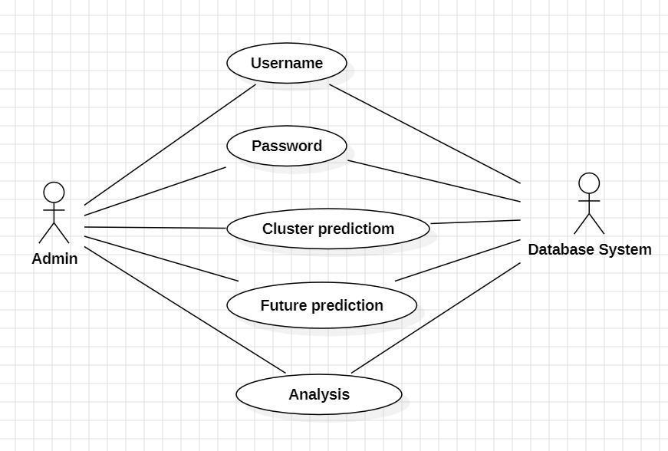










UML DIAGRAMS:
USE CASE DIAGRAM

Slide 16
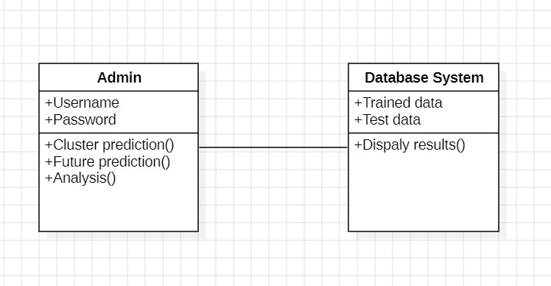
CLASS DIAGRAM

Slide 17
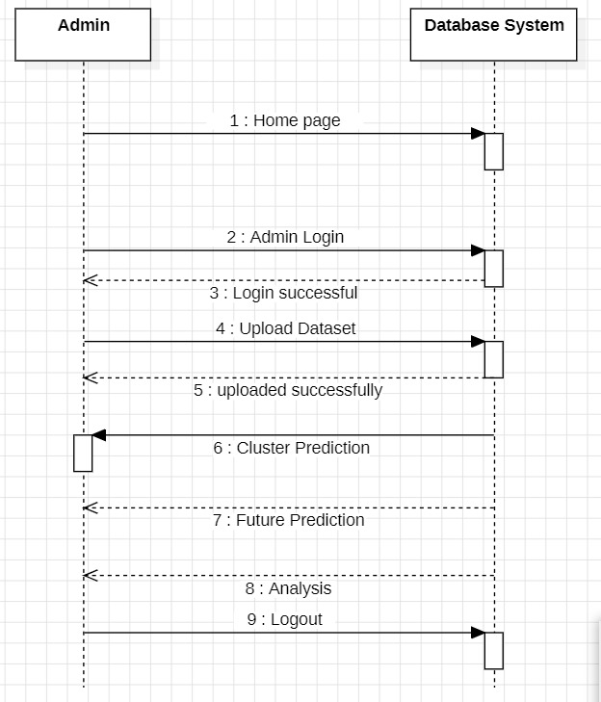
SEQUENCE DIAGRAM

Slide 18
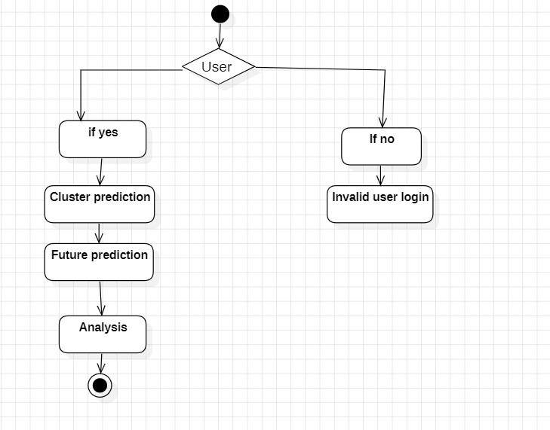
ACTIVITY DIAGRAM

Slide 19
SAMPLE CODE
from django.shortcuts import render
from django.template import RequestContext
from django.contrib import messages
from django.http import HttpResponse
import os
import matplotlib.pyplot as plt
import pandas as pd
import numpy as np
from sklearn.preprocessing import LabelEncoder
from sklearn.preprocessing import MinMaxScaler
from sklearn.ensemble import RandomForestRegressor
from sklearn.model_selection import train_test_split
from sklearn.cluster import Kmeans
global dataset, kmeans_cluster, theft_cls, rape_cls, murder_cls
sc = MinMaxScaler(feature_range = (0, 1))
le1 = LabelEncoder()

Slide 20
le2 = LabelEncoder()
le3 = LabelEncoder()
le4 = LabelEncoder()
def UploadDatasetAction(request):
if request.method == 'POST':
global dataset, kmeans_cluster, theft_cls, rape_cls, murder_cls
myfile = request.FILES['t1']
dataset = pd.read_csv("Dataset/Dataset.csv", usecols=['States/UTs','District', 'Murder', 'Rape', 'Theft', 'Dowry_Deaths',’Year'])
dataset.fillna(0, inplace = True)
cols = ['States/UTs', 'District']
dataset[cols[0]] = pd.Series(le1.fit_transform(dataset[cols[0]].astype(str)))
dataset[cols[1]] = pd.Series(le2.fit_transform(dataset[cols[1]].astype(str)))
X = dataset.values
X = sc.fit_transform(X)
kmeans_cluster = KMeans(n_clusters=2, n_init=1200)
kmeans_cluster.fit(X)
dataset = pd.read_csv("Dataset/Dataset.csv", usecols=['States/UTs','District', 'Year', 'Theft', 'Murder', 'Rape'])
dataset.fillna(0, inplace = True)

Slide 21
cols = ['States/UTs', 'District']
dataset[cols[0]] = pd.Series(le3.fit_transform(dataset[cols[0]].astype(str)))
dataset[cols[1]] = pd.Series(le4.fit_transform(dataset[cols[1]].astype(str)))
theft_Y = dataset['Theft'].values
murder_Y = dataset['Murder'].values
rape_Y = dataset['Rape'].values
dataset.drop(['Theft'], axis = 1,inplace=True)
dataset.drop(['Murder'], axis = 1,inplace=True)
dataset.drop(['Rape'], axis = 1,inplace=True)
X = dataset.values
theft_cls = RandomForestRegressor()
theft_cls.fit(X, theft_Y)
rape_cls = RandomForestRegressor()
rape_cls.fit(X, rape_Y)
murder_cls = RandomForestRegressor()
murder_cls.fit(X, murder_Y)
dataset = pd.read_csv("Dataset/Dataset.csv")
dataset.fillna(0, inplace = True)
columns = list(dataset.columns)
strdata = '<table border=1 align=center width=100%><tr><th><font size="" color="black">'+columns[0]+'</th>'

Slide 22
for i in range(1,len(columns)):
strdata+='<th><font size="" color="black">'+columns[i]+'</th>' strdata += "</tr>" dataset = dataset.values
for i in range(len(dataset)):
strdata += "<tr>"
for j in range(len(dataset[i])):
Strdata+='<td><font size="" color="black">'+str(dataset[i,j])+'</td>'
strdata += "</tr>"
context= {'data':strdata}
return render(request, 'ViewDataset.html', context)
def AdminLogin(request):
if request.method == 'POST':
user = request.POST.get('t1', False)
password = request.POST.get('t2', False)
if user == 'admin' and password == 'admin':
context= {'data':user}
return render(request, 'AdminScreen.html', context)
def index(request):
if request.method == 'GET':
return render(request, 'index.html', {})

Slide 23
def Admin(request):
if request.method == 'GET':
return render(request, 'Admin.html', {})
def UploadDataset(request):
if request.method == 'GET':
return render(request, 'UploadDataset.html', {})
def ClusterPrediction(request):
if request.method == 'GET':
dataset = pd.read_csv("Dataset/Dataset.csv", usecols=['States/UTs','District', 'Year'])
dataset.fillna(0, inplace = True)
states = np.unique(dataset['States/UTs'].values)
output = '<tr><td><font size="" color="black">States</b></td><td><select name="t1">'
for i in range(len(states)):
output += '<option value="'+states[i]+'">'+states[i]+'</option>'
output += "</select></td></tr>"
output += '<tr><td><font size="" color="black">District</b></td><td><select name="t2">‘
for i in range(len(states)):
district = dataset[dataset['States/UTs'] == states[i]]['District']
district = district.values
output += '<option value="'+states[i]+'"><b>--'+states[i]+'--</b></option>‘
for j in range(len(district)):

Slide 24
output += '<option value="'+district[j]+'">'+district[j]+'</option>'
output += "</select></td></tr>"
output += '<tr><td><font size="" color="black">Year</b></td><td><select name="t3">'
year = np.unique(dataset['Year'].values)
for i in range(len(year)):
output += '<option value="'+str(year[i])+'">'+str(year[i])+'</option>'
output += "</select></td></tr>"
context= {'states':output}
return render(request, 'ClusterPrediction.html', context)
def ClusterPredictionAction(request):
if request.method == 'POST':
state = request.POST.get('t1', False)
district = request.POST.get('t2', False)
year = request.POST.get('t3', False)
murder = request.POST.get('t4', False)
rape = request.POST.get('t5', False)
theft = request.POST.get('t6', False)
dowry = request.POST.get('t7', False)
temp = [] temp.append([state, district, murder, rape, theft, dowry, year])
test = pd.DataFrame(temp, columns=['States/UTs','District', 'Murder', 'Rape', 'Theft', 'Dowry_Deaths', 'Year'])

Slide 25
test.fillna(0, inplace = True)
test['States/UTs'] = pd.Series(le1.transform(test['States/UTs'].astype(str)))
test['District'] = pd.Series(le2.transform(test['District'].astype(str)))
test = test.values
test = sc.transform(test)
predict = kmeans_cluster.predict(test)
print(predict)
output = district+" Low Crime Rate Area"
if predict == 1:
output = district+" High Crime Rate Area"
context= {'data':output}
return render(request, 'index.html', context)
def FuturePrediction(request):
if request.method == 'GET':
dataset = pd.read_csv("Dataset/Dataset.csv", usecols=['States/UTs','District', 'Year']) dataset.fillna(0, inplace = True)
states = np.unique(dataset['States/UTs'].values)
output = '<tr><td><font size="" color="black">States</b></td><td><select name="t1">‘
for i in range(len(states)):
output += '<option value="'+states[i]+'">'+states[i]+'</option>'

Slide 26
output += '<tr><td><font size="" color="black">District</b></td><td><select name="t2">‘
for i in range(len(states)):
district = dataset[dataset['States/UTs'] == states[i]]['District']
district = district.values output += '<option value="'+states[i]+'"><b>--'+states[i]+'-- </b></option>'
for j in range(len(district)):
output += '<option value="'+district[j]+'">'+district[j]+'</option>'
output += "</select></td></tr>"
output += '<tr><td><font size="" color="black">Year</b></td><td><select name="t3">'
year = np.unique(dataset['Year'].values)
for i in range(len(year)):
output += '<option value="'+str(year[i])+'">'+str(year[i])+'</option>'
output += '<option value="2022">2022</option>'
output += '<option value=2023>2023</option>'
output += "</select></td></tr >"
context= {'states':output}
return render(request, 'FuturePrediction.html', context)

Slide 27
def AnalysisAction(request):
if request.method == 'POST':
classify_type = request.POST.get('t1', False)
strdata = '<table border=1 align=center width=100%>'
if classify_type == "Theft":
strdata += '<tr><td><img src="static/analysis/theft_bar.png" height="300" width="500"/></td></tr>'
strdata += '<tr><td><img src="static/analysis/theft_pie.png" height="300" width="500"/></td></tr>'
if classify_type == "Murder":
strdata += '<tr><td><img src="static/analysis/murder_bar.png" height="300" width="500"/></td></tr>'
strdata += '<tr><td><img src="static/analysis/murder_pie.png" height="300" width="500"/></td></tr>'
if classify_type == "Rape":
strdata += '<tr><td><img src="static/analysis/rape_bar.png" height="300" width="500"/></td></tr>'
strdata += '<tr><td><img src="static/analysis/rape_pie.png" height="300" width="500"/></td></tr>'
context= {'data':strdata}
return render(request, 'ViewGraphs.html', context)

Slide 28
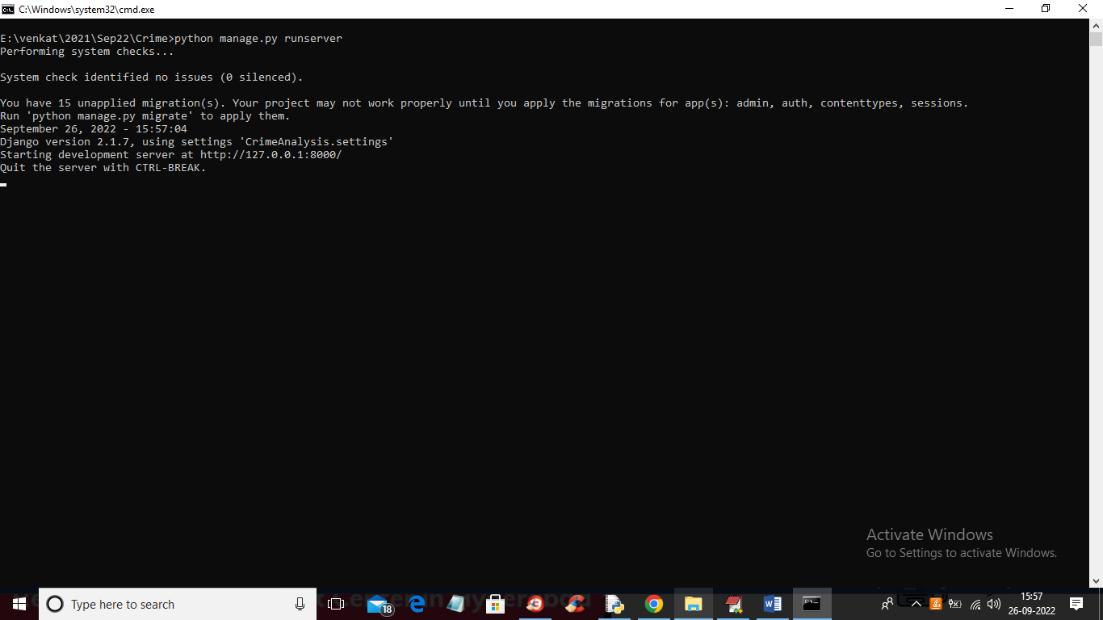
RESULTS
In above screen python server started and now open browser and enter URL as ‘http://127.0.0.1:8000/index.html’ and press enter key to get below page

Slide 29
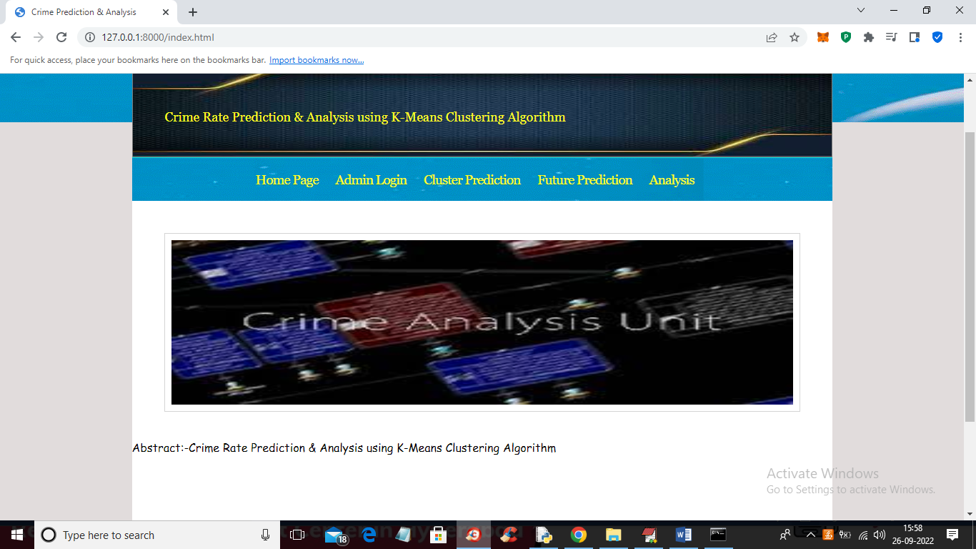
In above screen click on ‘Admin Login’ link to get below login page

Slide 30
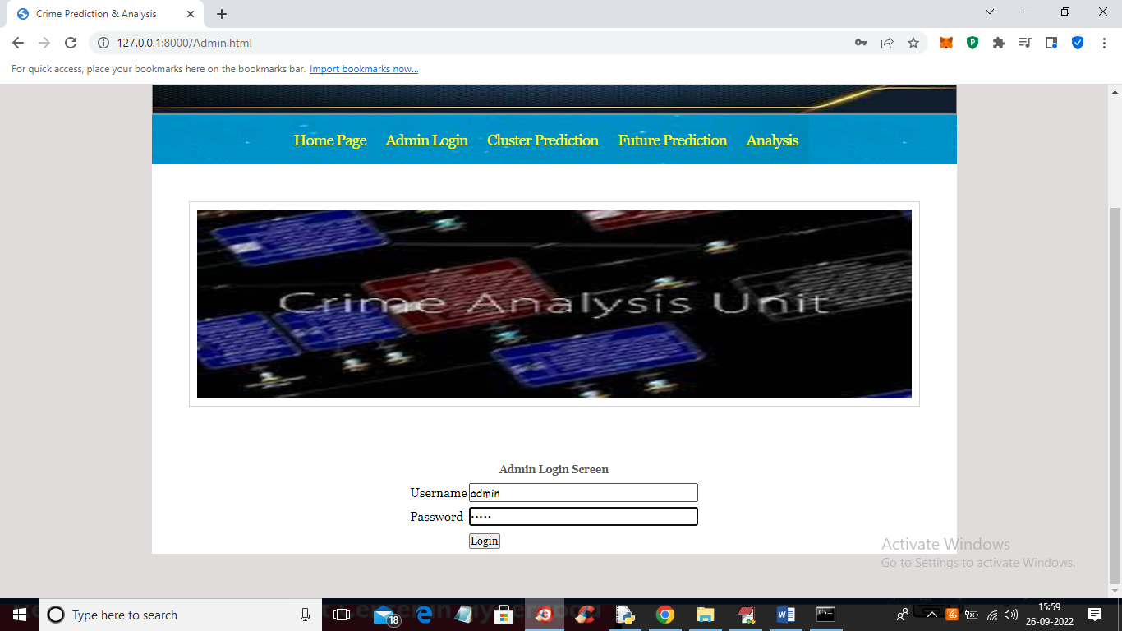
In above screen admin is login and after login will get below screen

Slide 31
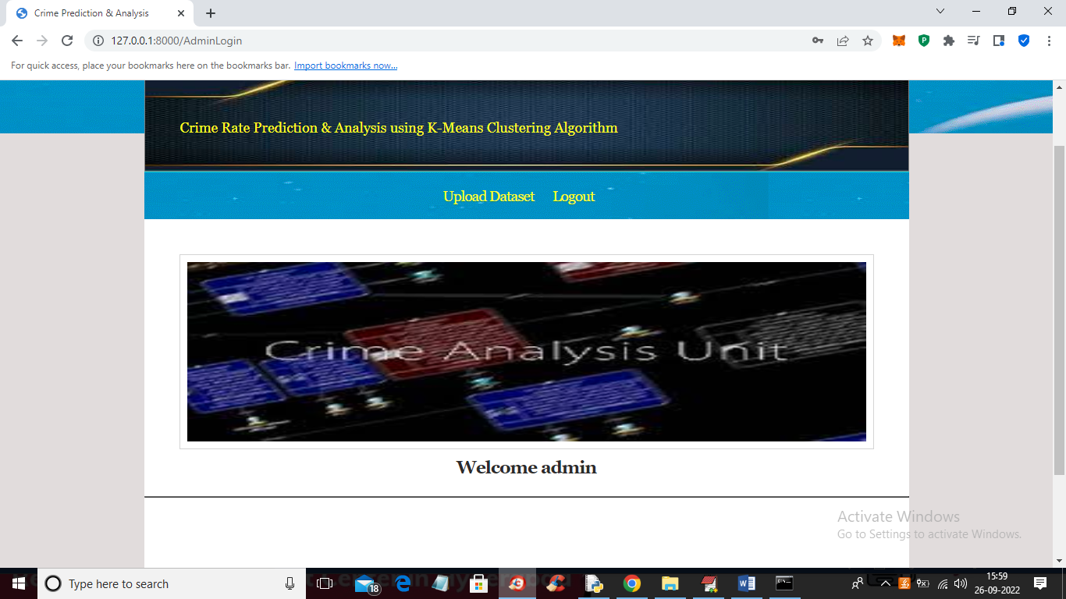
In above screen admin can click on ‘Upload Dataset’ link to upload dataset and then click submit button to load dataset and then train it with machine learning algorithms

Slide 32
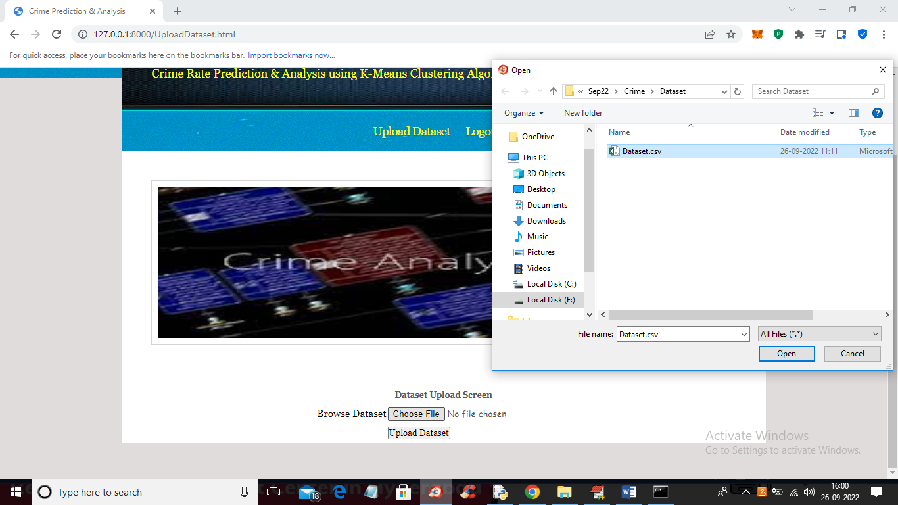
In above screen selecting and upload dataset and then click on ‘Open’ and ‘Upload Dataset’ button to load and complete training process and get below output

Slide 33
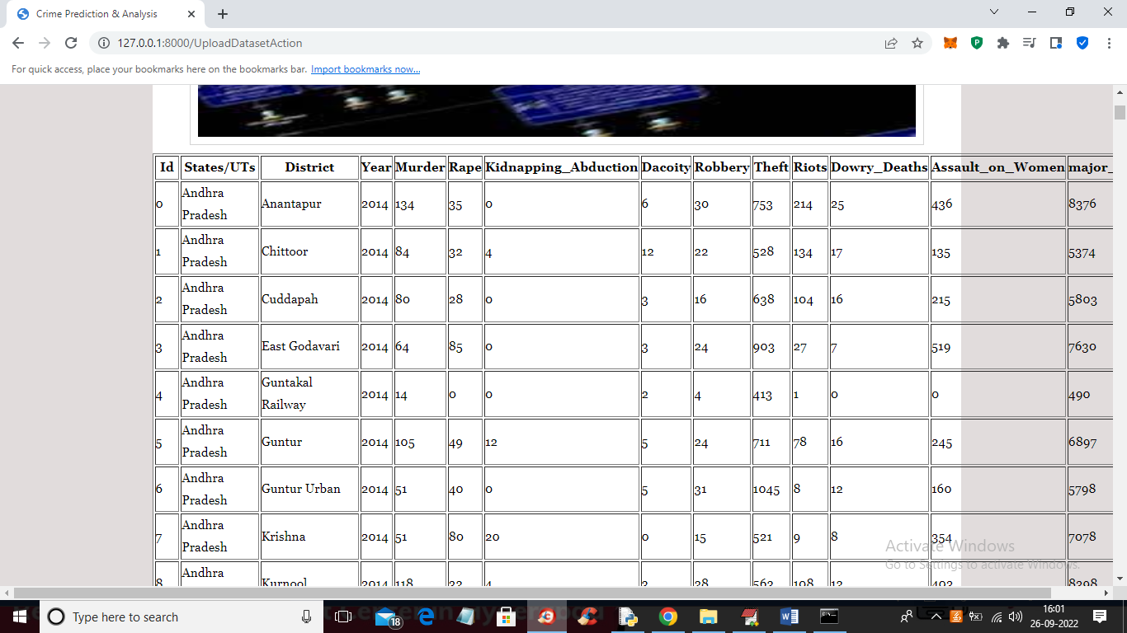
In above screen training is completed and then we got all dataset details and now click on ‘Logout’ link to get below screen

Slide 34

In above screen click on ‘Cluster Prediction’ link to get below screen

Slide 35
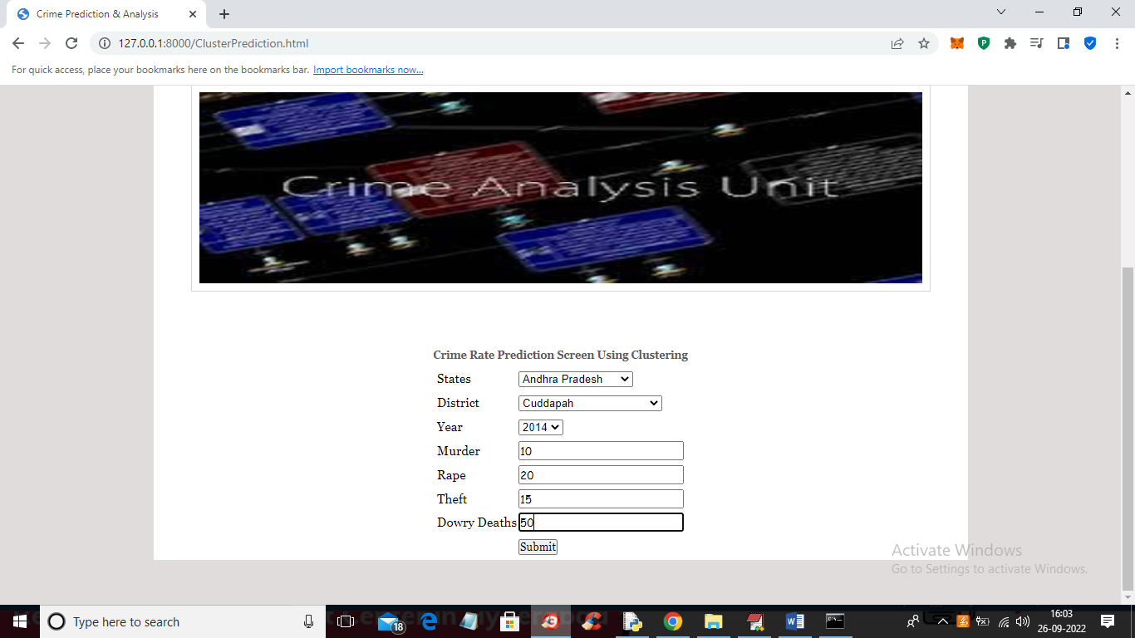
In above screen select state and district name and then enter details of crime and then press ‘Submit’ button to get below output

Slide 36
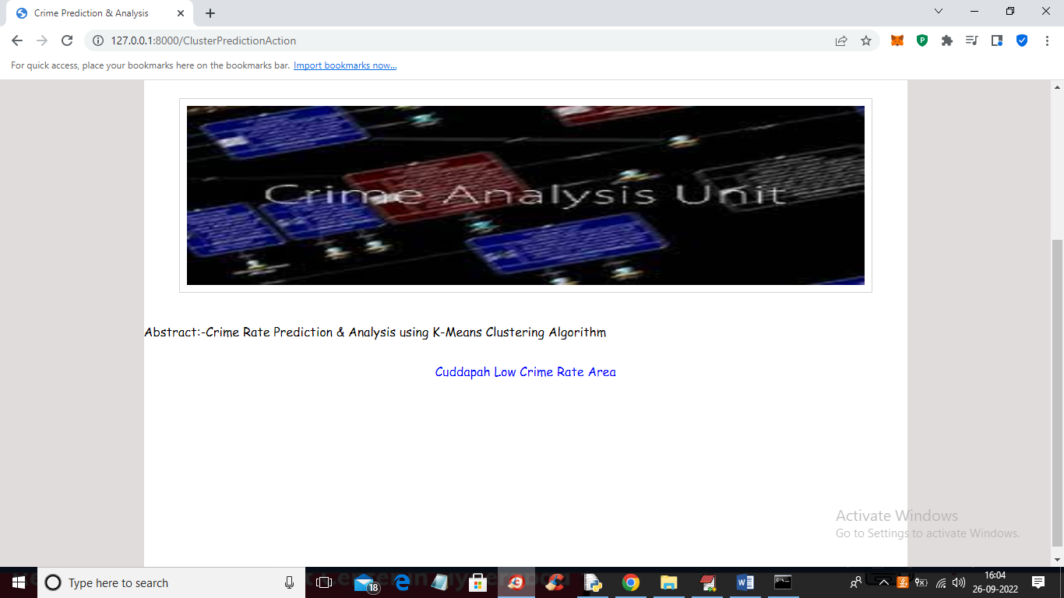
In above screen in blue colour we got output as ‘Cuddapah is the Low Crime Area. and similarly we can test any other state. And now click on ‘Future Prediction’ link to get below screen

Slide 37
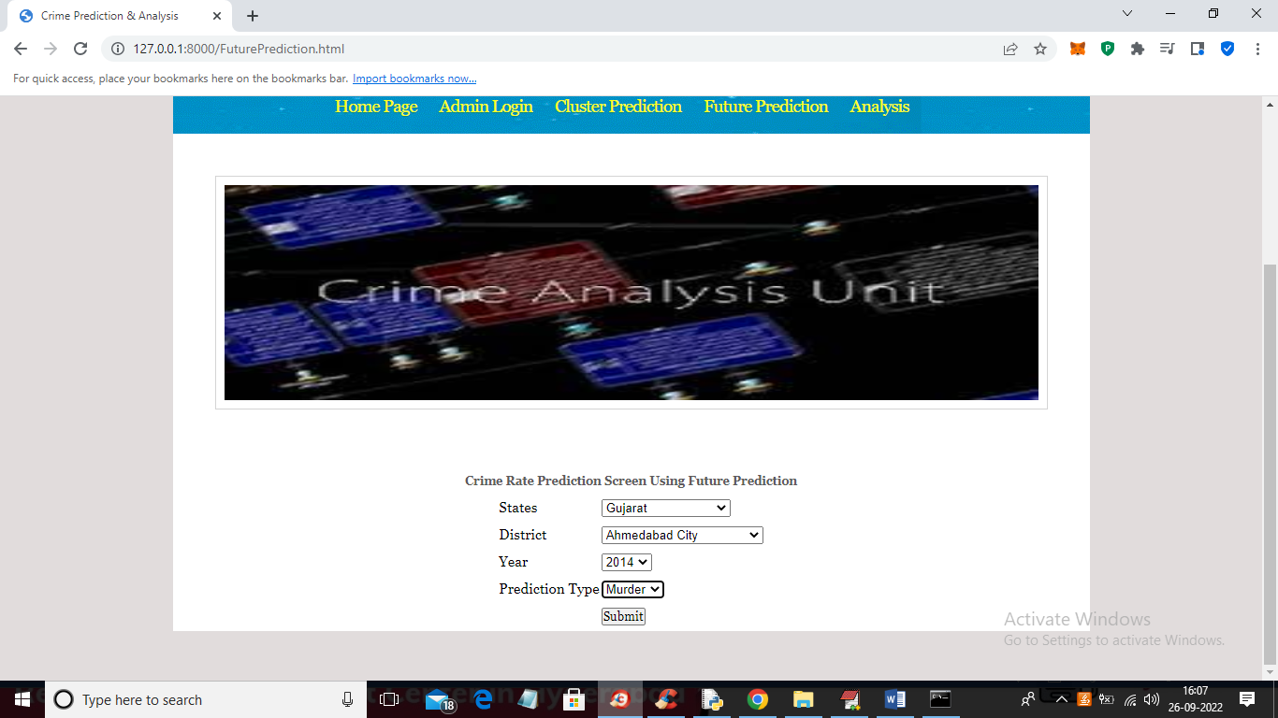
In above screen I selected state, district and then select crime as ‘Murder’ and then press ‘Submit’ button to get below output

Slide 38
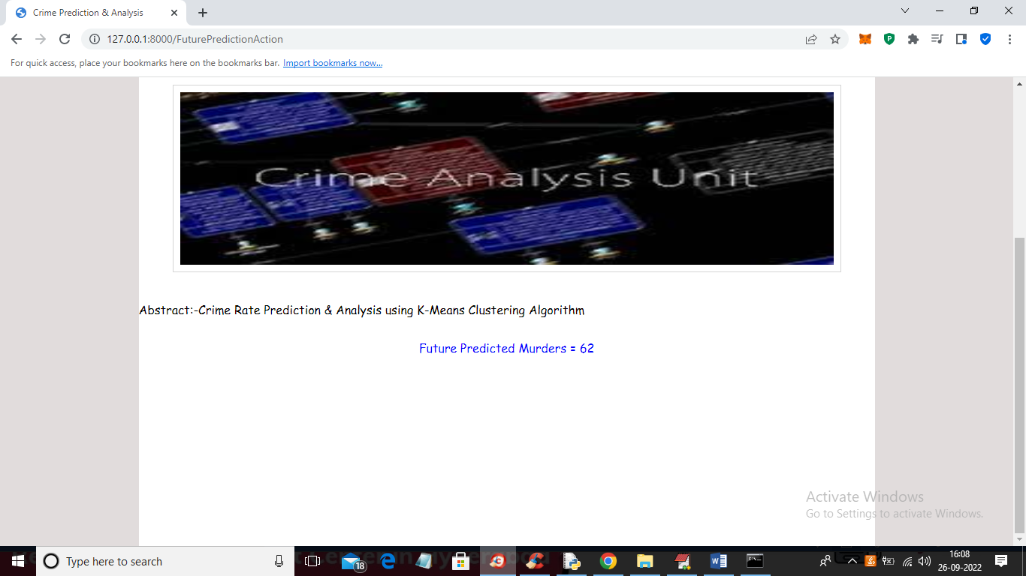
In above screen future predicted Murders for Gujarat state and Ahmadabad district is 62 and similarly you can select option and get future prediction and now click on ‘Analysis’ link to get below screen

Slide 39
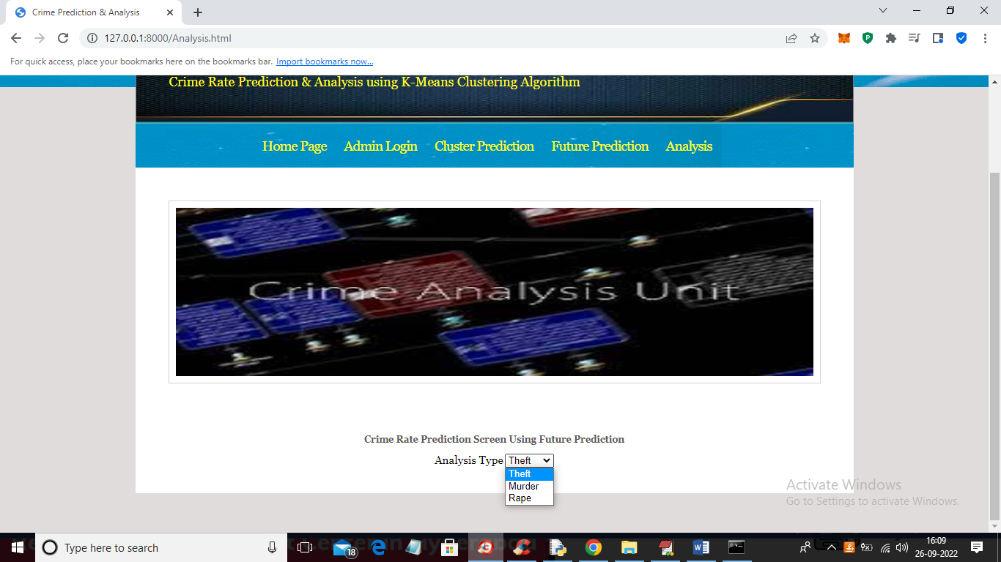
In above screen select the type of analysis and press button to get below graphs

Slide 40
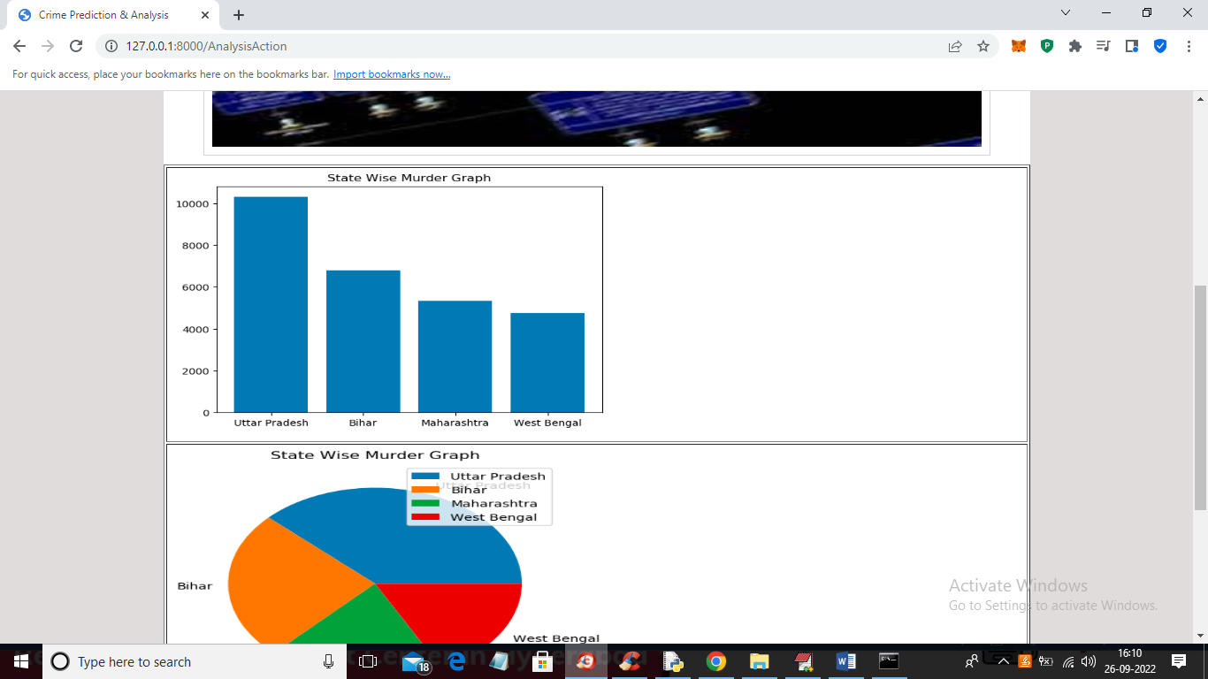

Slide 41
CONCLUSION:
The project focuses on crime analysis using a clustering algorithm applied to a crime dataset.
Rapid Miner is the tool used for this analysis.
A key finding is that homicide rates have been decreasing over this time period.
The analysis facilitates easy identification of crime trends over the years.
These insights can be utilized to design precautionary measures for the future.

Slide 42
FUTURE SCOPE
From the encouraging results, we believe that crime data mining has a promising future for increasing the effectiveness and efficiency of criminal and intelligence analysis.
Visual and intuitive criminal and intelligence investigation techniques can be developed for crime pattern.
As we have applied clustering technique of data mining for crime analysis we can also perform other techniques of data mining such as classification.
Also we can perform analysis on various dataset such as enterprise survey dataset, poverty dataset, aid effectiveness dataset, etc.

Slide 43
REFERENCES
[1] De Bruin ,J.S.,Cocx,T.K,Kosters,W.A.,Laros,J.and Kok,J.N(2006) Data mining approaches to criminal carrer analysis ,”in Proceedings of the Sixth International Conference on Data Mining (ICDM”06) ,Pp. 171-177.
[2] Manish Gupta1*, B.Chandra1 and M. P. Gupta1,2007 Crime Data Mining for Indian Police Information System.
[3] Nazlena Mohamad Ali1, Masnizah Mohd2, Hyowon Lee3, Alan F. Smeaton3, Fabio Crestani4 and Shahrul Azman Mohd Noah2 ,2010 Visual Interactive Malaysia Crime News Retrieval System.
[4] Sutapat Thirprungsri Rutgers University .USA ,2011 Cluster Analysis of Anomaly Detection in Accounting Data : An Audit Approach 1.

Slide 44
[5] A.Malathi ,Dr.S.Santhosh Baboo. D.G. Vaishnav College,Chennai ,2011 Algorithmic Crime Prediction Model Based on the Analysis of Crime Clusters.
[6] Malathi.A 1 ,Dr.S.Santhosh Baboo 2 and Anbarasi . A 31 Assistant professor ,Department of Computer Science ,Govt Arts College ,Coimbatore , India . 2 Readers , Department of Computer science , D.G. Vaishnav Collge ,Chennai , India, 2011 An intelligent Analysis of a city Crime Data Using Data Mining.
[7] Malathi , A; Santhosh Baboo , S, 2011 An Enhanced Algorithm to Predict a Future Crime using Data Mining.
[8] Kadhim B.Swadi al-Janabi . Department of Computer Science . Faculty of Mathematics and Computer Science .University of Kufa/Iraq , 2011 A Proposed Framework for Analyzing Crime DataSet using Decision Tree and Simple K-means Mining Algorithms.

Slide 45
GITHUB LINK

Slide 46
THANK YOU…

